Slide 1
State Diagrams

Slide 2
What are state diagrams
State diagrams are created in order to give you an idea of different states an object can be in
They should explain in some detail what each state is, and how the object goes from that state to another state
It will also include information on beginning state and final state

Slide 3
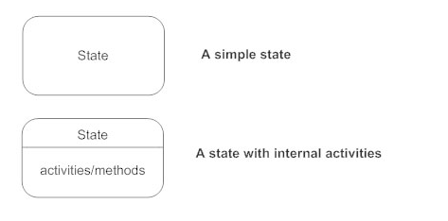


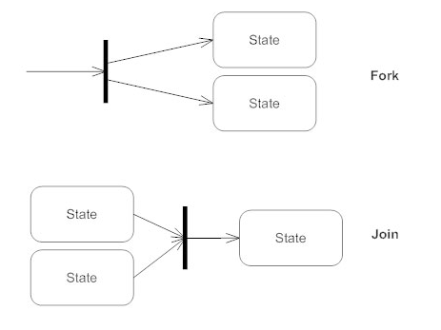

Symbols
Decision Pseudostate

Slide 4
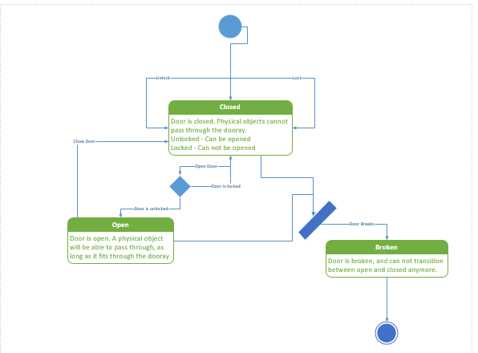
Example 1 in real life: a door

Slide 5
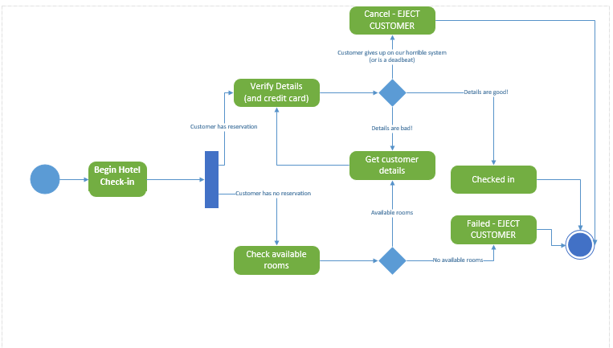
Example 2: checking in to a hotel

